Slide 1
ELECTRONICS RETAIL · DATA ANALYTICS CASE STUDY
Sales and Revenue Trends
2016 – 2020
An analysis of sales performance, store performance, and customer trends across the Global Electronics Retailer network.
Yisel Alvarado Ayala
Portfolio Project · 2026

Slide 2




INTRODUCTION
About the Company & Analysis Goals
Analysis Goals
About the Company
Sales Performance
Global Electronics Retailer is a fictional global company specializing in electronic devices, home appliances, and technology solutions. It operates both online and through physical stores worldwide.
Identify and understand sales performance across product categories.
Store Performance
Evaluate store performance across the global retail network.
50+
2016–2020
3
Stores worldwide
Years analyzed
Analysis goals
Customer Trends
Identify customer and sales trends over time from 2016 to 2020.
GLOBAL ELECTRONICS RETAILER · SALES & REVENUE ANALYSIS 2016–2020
2

Slide 3




METHODOLOGY
Process
A structured, cloud-based workflow was used to collect, store, query, and visualize the data.
01
02
03
04
05
Download Dataset
Azure SQL Setup
Load Data
Connect & Query
Visualize & Collaborate
Downloaded the Global Electronics Retailer dataset from Maven Analytics.
Created the Azure SQL Database using the Azure for Students free tier and built all tables using the Query Editor.
Loaded CSV data using a custom Python script (load_data.py) with the pyodbc library, then exported the database as a .bacpac backup.
Connected Azure SQL to VS Code using the mssql and DBCode extensions, then wrote 12 T-SQL queries across three analysis goals.
Built visualizations using DBCode's charting feature and collaborated via GitHub with a shared repository.
›
›
›
›
GLOBAL ELECTRONICS RETAILER · SALES & REVENUE ANALYSIS 2016–2020
3

Slide 4



ANALYSIS & FINDINGS · 1 OF 3
Sales Performance
Home Appliances lead profitability
Home Appliances lead average profit per unit despite not being the highest-volume category.
8
“Silent killer” products identified — high volume but ranked outside the top 20 on profit.
Computers & Cell Phones: high volume, mid-tier margin
These categories sell the most units but rank mid-tier on profitability — volume isn't translating into proportional profit.
Pricing on these SKUs is the fastest lever for margin recovery.
GLOBAL ELECTRONICS RETAILER · SALES & REVENUE ANALYSIS 2016–2020
4

Slide 5

ANALYSIS & FINDINGS · 2 OF 3
Store Performance
18
7
32
High Performers
Medium Performers
Low Performers
Revenue concentrated in North America
Size doesn't predict revenue
Top revenue stores are concentrated in Canada and the United States, while European stores consistently underperform by comparison.
Store size does not strongly correlate with revenue — Wyoming has only 840 sq m but ranks #14 in total revenue network-wide.
GLOBAL ELECTRONICS RETAILER · SALES & REVENUE ANALYSIS 2016–2020
5

Slide 6

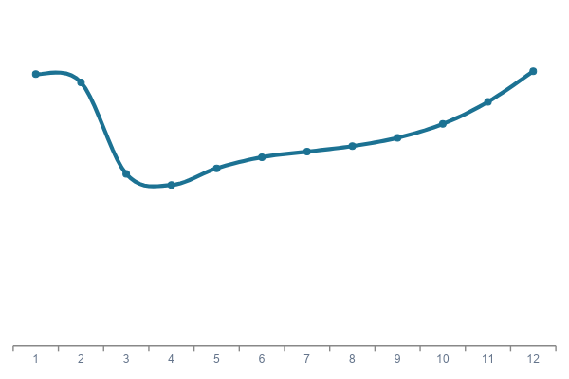

ANALYSIS & FINDINGS · 3 OF 3
Trends Over Time
Seasonal peaks and dips
Illustrative Monthly Sales Pattern
Sales peak in January and February, drop sharply in March–April, then stabilize with a December uptick.
Concentrated customer base
The customer base is concentrated in a handful of countries rather than spread evenly worldwide.
Year-over-year growth
Year-over-year unit growth shows the business is expanding overall despite seasonal volatility.
GLOBAL ELECTRONICS RETAILER · SALES & REVENUE ANALYSIS 2016–2020
6

Slide 7
CONCLUSION & RECOMMENDATIONS
The company is profitable and growing - but there are clear optimization opportunities that can accelerate performance further.
01
02
03
04
PHASE 1
PHASE 2
PHASE 3
PHASE 4
Reprice silent-killer products
Replicate top-store practices
Align spend with seasonality
Expand in underserved markets
Reevaluate pricing on silent-killer products — small margin gains compound fast at high volume.
Study what makes top-performing stores successful and apply those lessons to Low Performer locations.
Align marketing budget with seasonal peaks — concentrate promotions around January/February and December.
Expand in underserved, high-population countries where customer count is low relative to market size.
GLOBAL ELECTRONICS RETAILER · SALES & REVENUE ANALYSIS 2016–2020
7

Slide 8


REFERENCES
Data, Tools & Acknowledgements
Dataset
GitHub Repository
Maven Analytics — Global Electronics Retailer
Shared project repository for collaboration, version control, and code sharing.
mavenanalytics.io/data-playground/global-electronics-retailer
github.com/yyalvaradoa-debug
AI Tools & Assistance
Google Gemini
Claude AI
Google Slides
Assistance with documentation.
Assistance with Python script and query structure.
Original presentation tool used for this slide deck.
GLOBAL ELECTRONICS RETAILER · SALES & REVENUE ANALYSIS 2016–2020
8

Slide 9

Thank You
Questions are welcome.
Contact
yyalvaradoa@gmail.com
Yisel Alvarado Ayala

